Slide 1
DASC 5301-002
Linear Regression I
Dr Subharag Sarkar
Fall 2023
Slides Courtesy - Rózsa Záruba

Slide 2
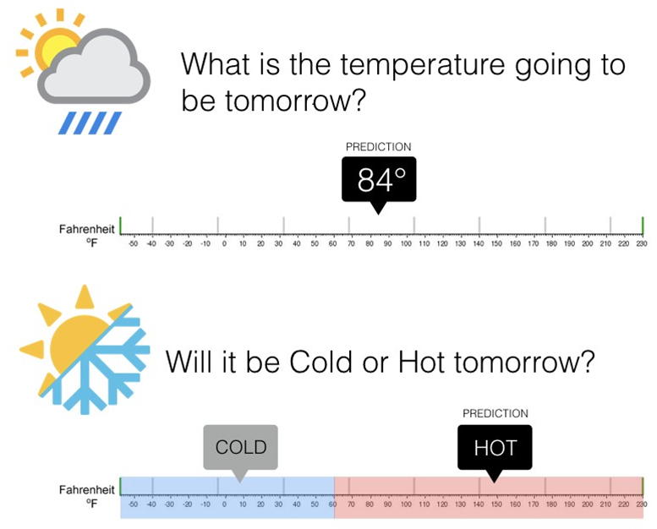
Regression ←→ Classification
Regression algorithms predict a continuous value based on the input variables.
Classification is the problem of identifying which of a set of categories an observation, belongs to

Slide 3
What are linear models?
In statistics, the term linear model is used in different ways according to the context.
The most common occurrence is in connection with regression models and the term is often taken as synonymous with linear regression model.
The designation "linear" is used to identify a subclass of models for which substantial reduction in the complexity of the related statistical theory is possible.

Slide 4
Linear Regression
Linear Regression is one of the most commonly used techniques in statistics.
It is used to quantify the relationship between one or more predictor variables and a response variable.
Simple linear regression, which is used to quantify the relationship between one predictor variable and one response variable.
Multiple linear regression, if we have more than one predictor variable

Slide 5
3 Major Questions
Causal Analysis
Forecasting an effect
Trend Forecasting.
Notes:
There are three major questions that the regression analysis answers

Slide 6
Causal Analysis
Business:
Is there a relationship between advertising spending and revenue?
Medicine:
Does the drug dosage have affected blood pressure of patients?
Has the body weight an influence on the blood cholesterol level?
Agriculture:
How fertilizer and water change crop yields.
Psychology:
Is anxiety influenced by personality traits?
Biology:
Does the oxygen level in water stimulate plant growth?
Notes:
Looks for a causal relationship between variables. In contrast to correlation analysis which does not indicate directionality of effects, the regression analysis assumes that the independent variable has an effect on the dependent variable.

Slide 7
Forecasting
Once we have our model, we can use it on new data to predict future values:
Medicine:
With X cigarettes smoked per day, the life expectancy is Y years.
Biology:
For five additional weeks of sunshine the sugar concentration in vine grapes will rise by X %
Management:
With X amount of dollars spend on marketing, sales should be Y.

Slide 8
Predict trends in data
Medicine:
By how many years does the life expectancy decrease for every additional pound overweight?
Biology:
With every additional week of sunshine, the sugar concentration in vine grapes will rise by Y%.

Slide 9
Pros
Simple model :
The Linear regression model is the simplest equation using which the relationship between the multiple predictor variables and predicted variable can be expressed.

Slide 10
Pros
Computationally efficient :
The modeling speed of Linear regression is fast as it does not require complicated calculations and runs predictions fast when the amount of data is large.

Slide 11
Pros
Interpretability of the Output:
The ability to determine the relative influence of one or more predictor variables to the predicted value when the predictors are independent of each other is one of the key reasons of the popularity of Linear regression.

Slide 12
Cons
Overly-Simplistic:
The Linear regression model is too simplistic to capture real world complexity
Linearity Assumption:
Linear regression makes strong assumptions that there is Predictor (independent) and Predicted (dependent) variables are linearly related which may not be the case.
Independence of variables :
Assumes that the predictor variables are not correlated which is rarely true.
Notes:
Last point (Etc. will see it later)

Slide 13
Variables in Regression
The regression framework is characterized by the following:
Response (dependent) variable:
This is the variable that we are interested in and want to model;
Examples: sales of a particular product, or the stock price of a publicly traded firm.

Slide 14
Variables in Regression
The regression framework is characterized by the following:
Predictor or explanatory (independent) variables:
A set of variables that we think might be useful in predicting or modelling the response variable
Example: The price of the product, the competitor's price or the profits, revenues, financial position of the firm, and so on.
In an experiment, the researcher is looking for the possible effect on the dependent variable that might be caused by changing the independent variable.

Slide 15
Response Variable versus Predicting Variable?
Response Variable:
It is a Random Variable. It varies with changes in the predictor/s along with other random changes.
Predicting Variable:
It is a Fixed Variable. It does not change with the response, but it is set fixed before the response is measured.

Slide 16
Response vs Predicting Variable
The effect of several types of cholesterol medications on LDL levels In humans.
Response Variable: Change in LDL levels
Predicting Variable: Type of Medication
The relationship between driving habits and fuel efficiency
Response Variable: Miles Per Gallon (MPG) of Fuel
Predicting Variable: Average Driving Speed
The relationship between college grade point average (GPA) and scores on the SAT
Response Variable: GPA
Predicting Variable: SAT score

Slide 17
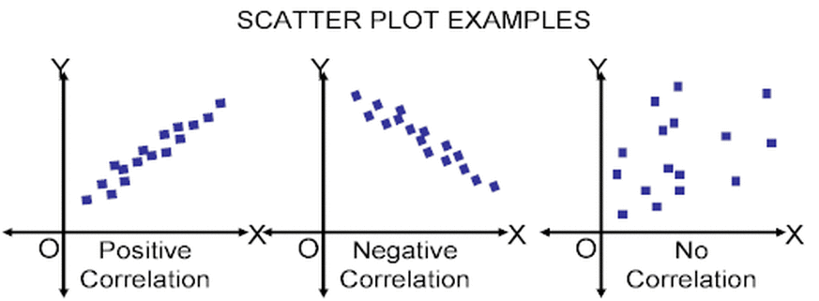
Two analyses study association of continuously measured variables
Correlation analysis: Concerned with measuring the strength and direction of the association between variables. The correlation of X and Y (Y and X).
Linear regression: Concerned with predicting the value of one variable based on (given) the value of the other variable. The regression of Y on X.

Slide 18
Types of Linear Regression

Slide 19
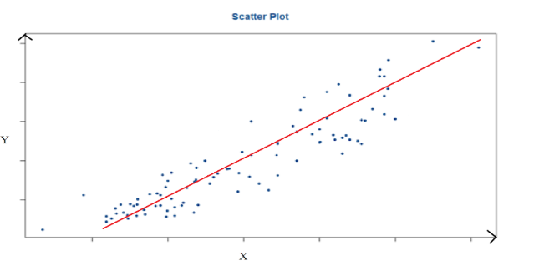
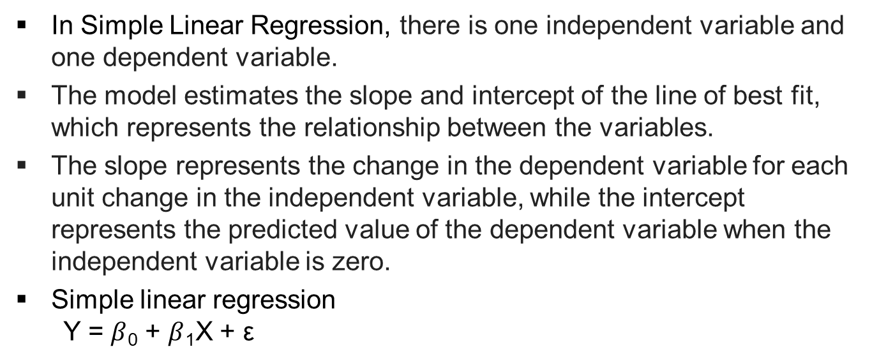
Simple Linear Regression
In Simple Linear Regression, there is one independent variable and one dependent variable.
The model estimates the slope and intercept of the line of best fit, which represents the relationship between the variables.
The slope represents the change in the dependent variable for each unit change in the independent variable, while the intercept represents the predicted value of the dependent variable when the independent variable is zero.
Simple linear regression Y = $β$₀ + $β$₁X + $\text{ε}$

Slide 20
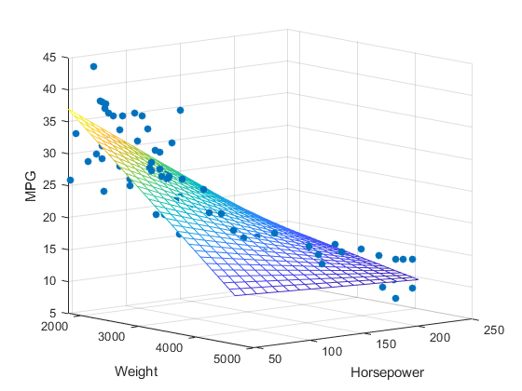
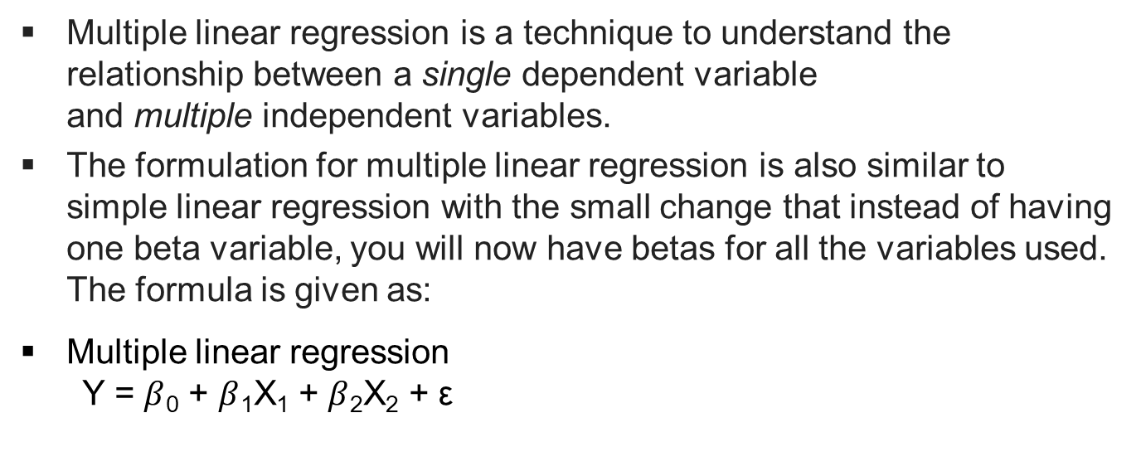
Multiple Linear Regression
Multiple linear regression is a technique to understand the relationship between a single dependent variable and multiple independent variables.
The formulation for multiple linear regression is also similar to simple linear regression with the small change that instead of having one beta variable, you will now have betas for all the variables used. The formula is given as:
Multiple linear regression Y = $β$₀ + $β$₁X₁ + $β$₂X₂ + $\text{ε}$

Slide 21
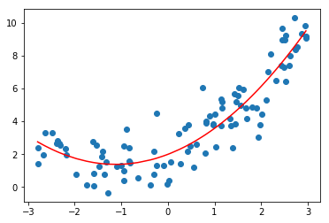
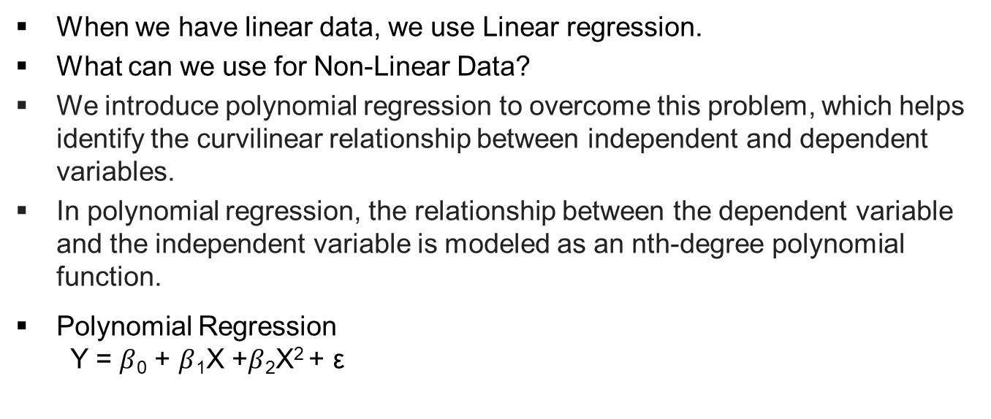
Polynomial Linear Regression
When we have linear data, we use Linear regression.
What can we use for Non-Linear Data?
We introduce polynomial regression to overcome this problem, which helps identify the curvilinear relationship between independent and dependent variables.
In polynomial regression, the relationship between the dependent variable and the independent variable is modeled as an nth-degree polynomial function.
Polynomial Regression Y = $β$₀ + $β$₁X +$β$₂X² + $\text{ε}$
Notes:
Last Point When the polynomial is of degree 2, it is called a quadratic model.
When the degree of a polynomial is 3, it is called a cubic model, and

Slide 22

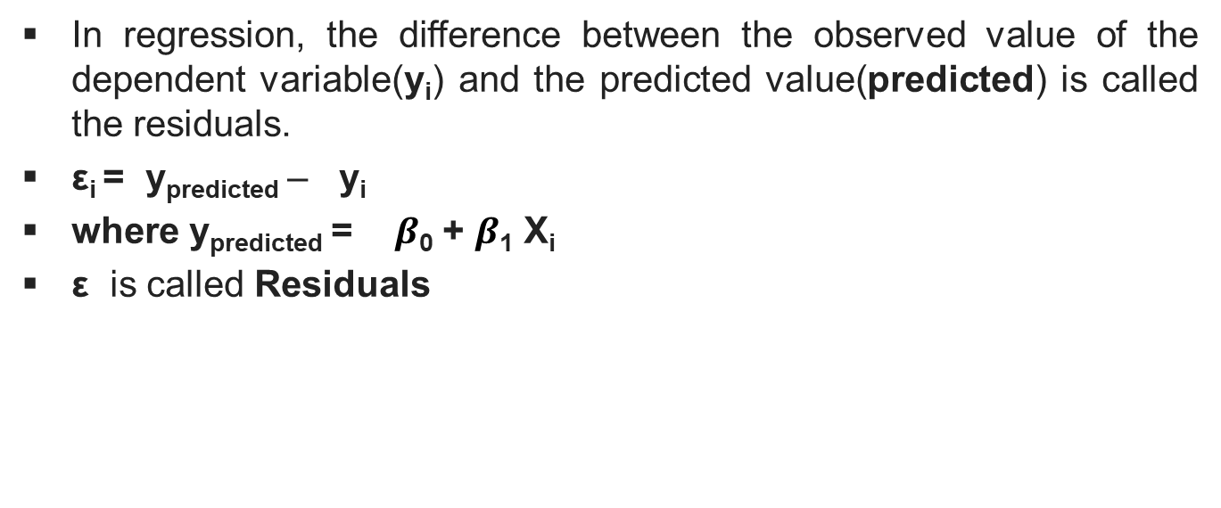
What is $\text{ε}$?
In regression, the difference between the observed value of the dependent variable(y_{i}) and the predicted value(predicted) is called the residuals.
ε_{i} = y_{predicted} – y_{i}
where y_{predicted} = $β$₀ + $β$₁ X_{i}
ε is called Residuals
Notes:
We used the epsilon in all the formulaes above but we don’t know what it means.
Whenever the model is trained on the independent variables, it provides us a predicted dependent variable. So the difference between the predicted y and actual y is the error then .
This error is called Residuals

Slide 23
Multiple Linear Regression: Objectives
A regression analysis is used for:
Prediction of the response variable;
Modelling the relationship between the response variable and the explanatory variables; or
Testing hypotheses of association relationships.
Linear Regression: The basis of what we will be talking about most of this class is the linear model. Virtually all other methods for studying dependence among variables are variations on the idea of linear regression.
All models are wrong, but some are useful. George Box
Embrace your data, not your models. John Tukey

Slide 24
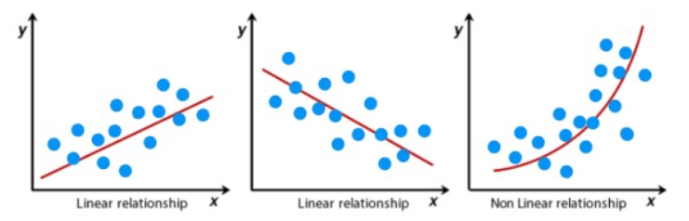
Assumptions of Linear Regression
Linearity of Residuals:
There needs to be a linear relationship between the dependent variable and independent variable(s).

Slide 25
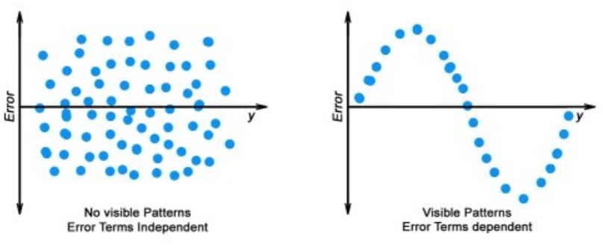
Assumptions of Linear Regression
Independence of Residuals:
The error terms should not be dependent on one another.
There should be no correlation between the residual terms.
The absence of this phenomenon is known as Autocorrelation.
There should not be any visible patterns in the error terms.
Notes:
First point (like in time-series data wherein the next value is dependent on the previous one).

Slide 26
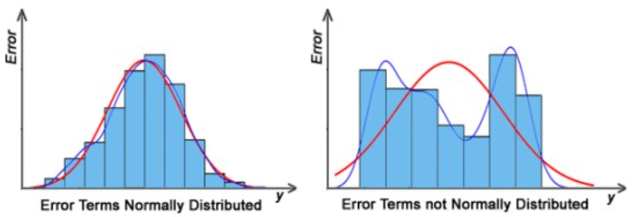
Assumptions of Linear Regression
Normal Distribution of Residuals:
The mean of residuals should follow a normal distribution with a mean equal to zero or close to zero.
This is done in order to check whether the selected line is actually the line of best fit or not.
If the error terms are non-normally distributed, suggests that there are a few unusual data points that must be studied closely to make a better model.

Slide 27
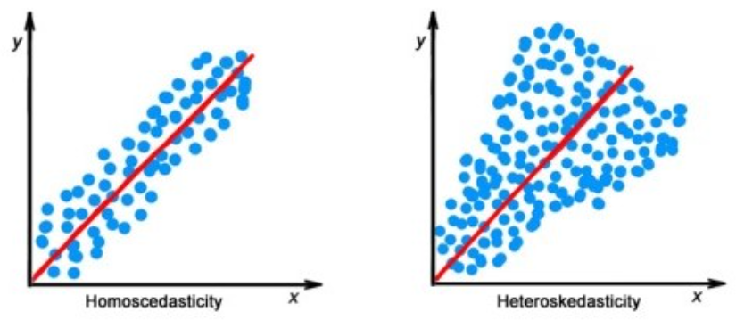
Assumptions of Linear Regression
The Equal Variance of Residuals:
The error terms must have constant variance. This phenomenon is known as Homoscedasticity.
The presence of non-constant variance in the error terms is referred to as Heteroscedasticity.
Notes:
Generally, non-constant variance arises in the presence of outliers or extreme leverage values.

Slide 28
Assumptions of Linear Regression
Multicollinearity:
There is no high correlation between the independent variables.
This indicates that there is little or no correlation between the independent variables.

Slide 29
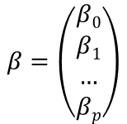
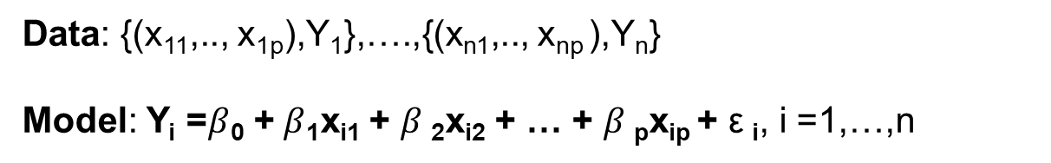
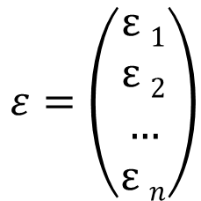
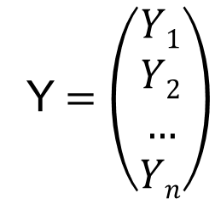
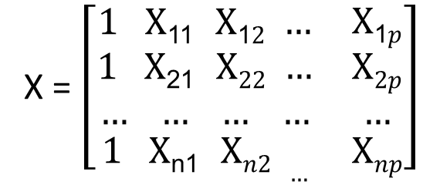

Multiple Linear Regression: Model
Data: {(x₁₁,.., x_{1p}),Y₁},….,{(x_{n1},.., x_{np} ),Y_{n}}
Model: Y_{i} =$β$₀ +$β$₁x_{i1} + $β$₂x_{i2} + … + $β$_{p}x_{ip} + $\text{ε}$_{i}, i =1,…,n
Model in Matrix Form: Y = X $β$ + $\text{ε}$
Design Matrix
Response
Error
Coefficients
X = $\left[\begin{matrix}\begin{aligned}1 \text{X}\text{11} \text{X}\text{1}2 … \\ 1 \text{X}\text{21} \text{X}22 … \\ … … … …\end{aligned} & \begin{aligned}\text{X}\text{1}p \\ \text{X}2p \\ …\end{aligned} \\ 1 \text{X}\text{n}\text{1} \text{X}n2 … & \text{X}np\end{matrix}\right]$
Y $=\left(\begin{aligned}Y1 \\ Y2 \\ … \\ Yn\end{aligned}\right)$
$ε=\left(\begin{aligned}\text{ε} 1 \\ \text{ε} 2 \\ … \\ \text{ε} n\end{aligned}\right)$
$$β=\left(\begin{aligned}β0 \\ β1 \\ … \\ βp\end{aligned}\right)$$

Slide 30
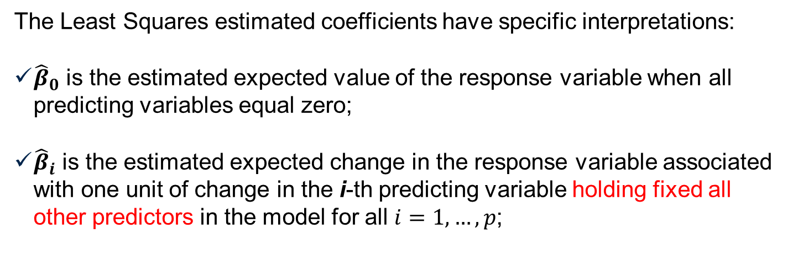
Model Interpretation: Parameters
The Least Squares estimated coefficients have specific interpretations:
${\hat{β}}_{0}$ is the estimated expected value of the response variable when all predicting variables equal zero;
${\hat{β}}_{i}$ is the estimated expected change in the response variable associated with one unit of change in the i-th predicting variable holding fixed all other predictors in the model for all $i=1,…,p$;

Slide 31
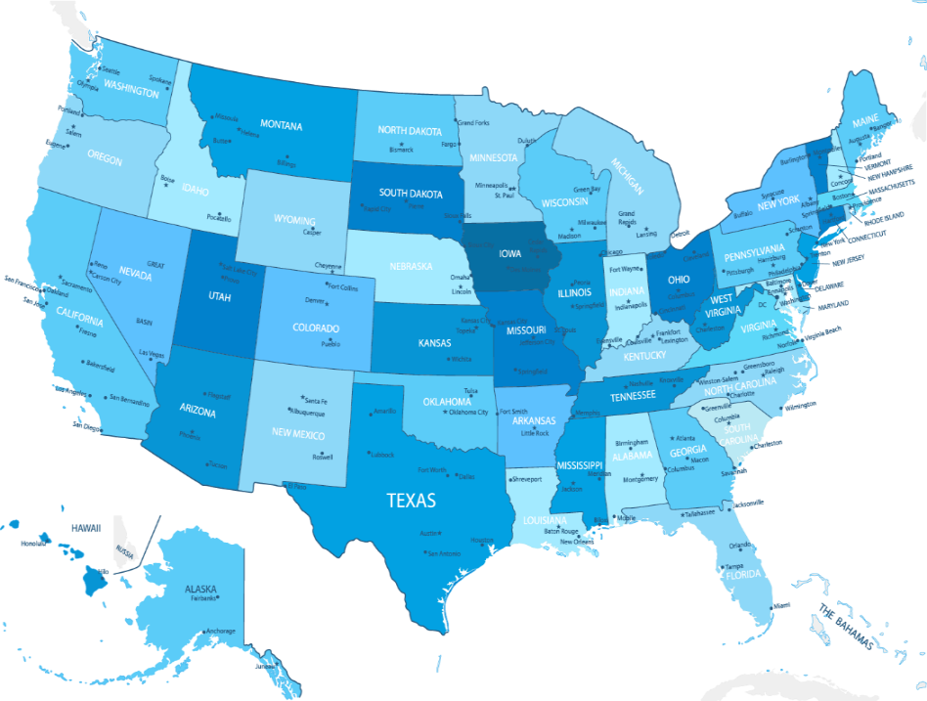
Linear Regression Example
SAT Mean Score by State – Year 1982
The response variable is:
Y = State average SAT score (verbal and quantitative combined)
The predicting variables are:
X₁ = % of total eligible students (high school seniors) in the state who took the exam
X₂ = median income of families of test takers, in hundreds of dollars
X₃ = average number of years that test takers had in social sciences, natural sciences, and humanities
X₄ = % of test takers who attended public schools
X₅ = state expenditure on secondary schools, in hundreds of dollars per student
X₆ = median percentile of ranking of test takers within their secondary school classes
790 (South Carolina) -1088 (Iowa)

Slide 32
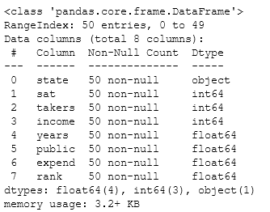
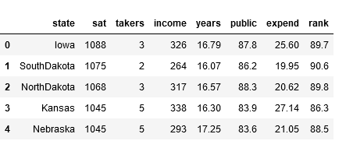
EDA SAT Dataset

Slide 33
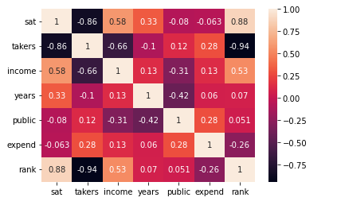
EDA SAT Dataset
Notes:
The heatmap shows how the data are related to each other.

Slide 34
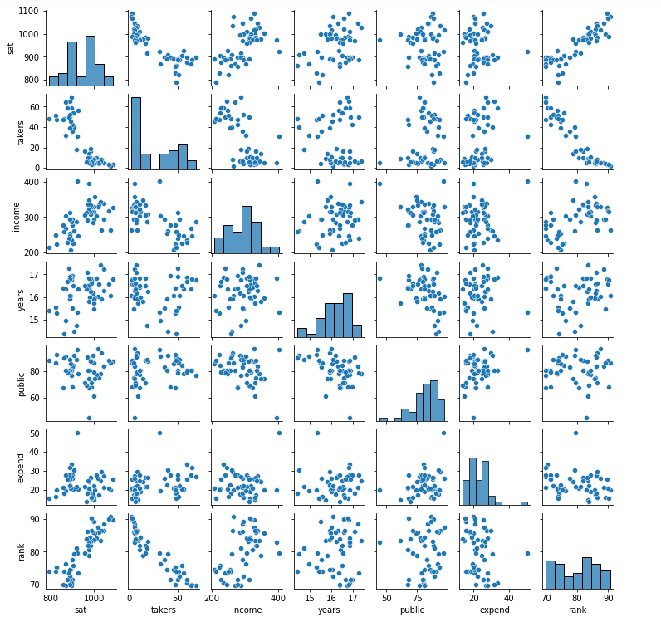
EDA SAT Dataset
Notes:
A correlogram or correlation matrix allows to analyse the relationship between each pair of numeric variables of a dataset. The relationship between each pair of variable is visualised through a scatterplot, or a symbol that represents the correlation (bubble, line, number..).
The diagonal often represents the distribution of each variable, using an histogram or a density plot.

Slide 35
What is OLS?
Ordinary least square:
Ordinary Least Squares regression (OLS) is a common technique for estimating coefficients of linear regression equations which describe the relationship between one or more independent quantitative variables and a dependent variable (simple or multiple linear regression).
Least squares stand for the minimum squares error (MSE).
The OLS method aims to minimize the sum of square differences between the observed and predicted values.
Python’s Statsmodels module contains the Ordinary Least Squares method of Linear Regression.
The summary it creates provides a lot of useful information about the Dataset.

Slide 36
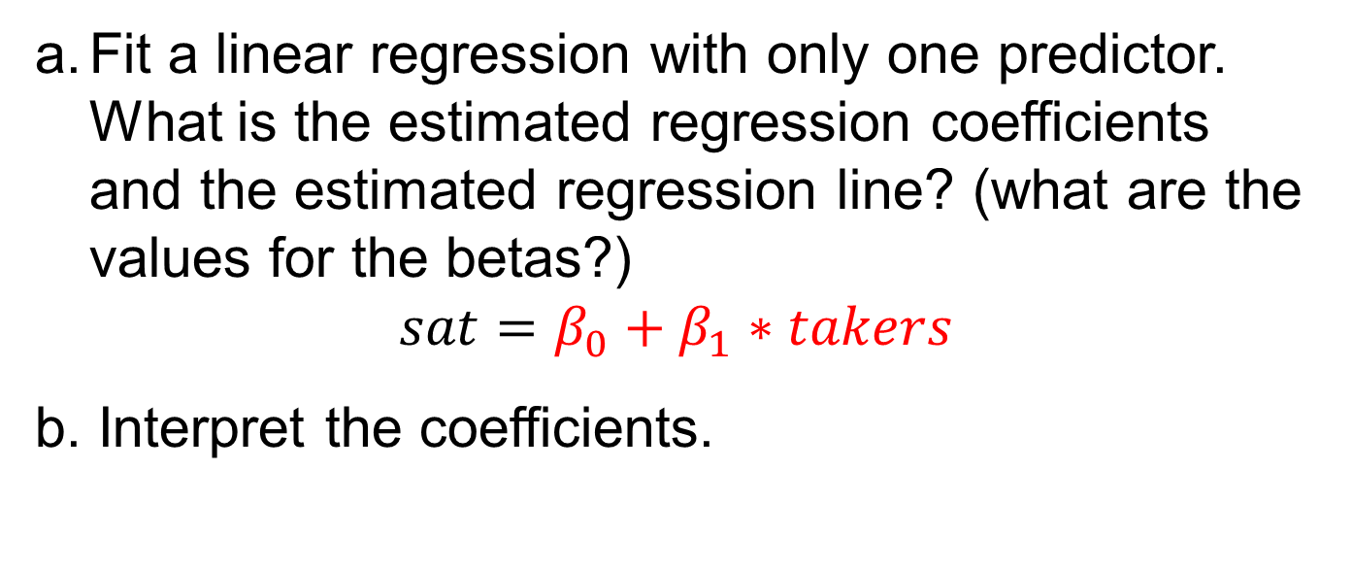
Simple Linear Regression
Fit a linear regression with only one predictor. What is the estimated regression coefficients and the estimated regression line? (what are the values for the betas?)
$$sat=β_{0}+β_{1}∗takers$$
b. Interpret the coefficients.

Slide 37
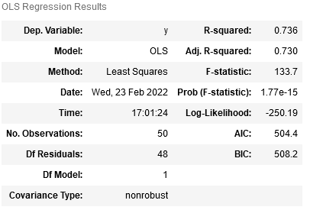
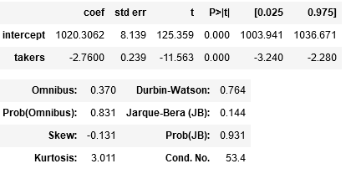
OLS Output
Intercept: The average SAT when takers= 0
Takers: A unit increase in the number of takers would decrease the SAT by 2.8 points
Variance of the model: 1353.89

Slide 38
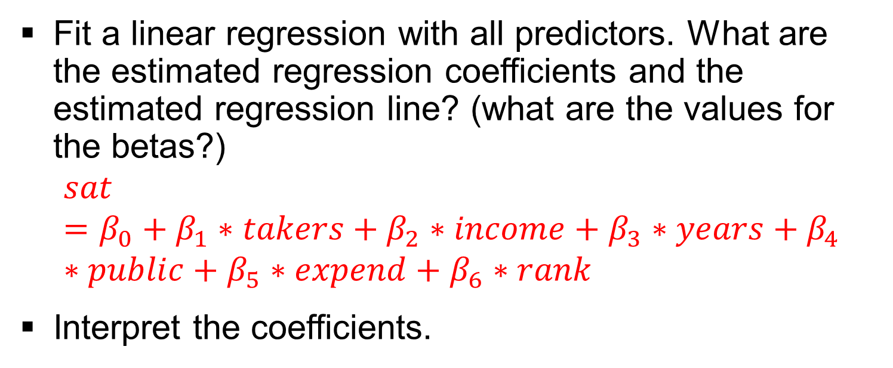
Multiple Linear Regression
Fit a linear regression with all predictors. What are the estimated regression coefficients and the estimated regression line? (what are the values for the betas?)
$$sat=β_{0}+β_{1}∗takers+β_{2}∗income+β_{3}∗years+β_{4}∗public+β_{5}∗expend+β_{6}∗rank$$
Interpret the coefficients.

Slide 39
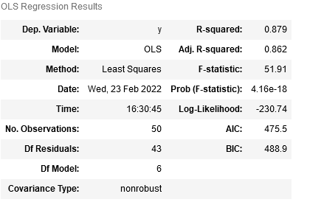
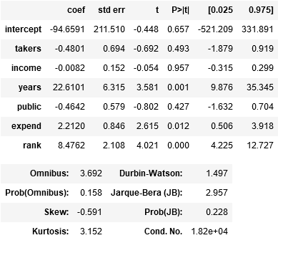
OLS output
Variance of the model: 694.01
Intercept: The average SAT when all other variables = 0
Takers: A unit increase in the number of takers would decrease the SAT by 0.5 points all else held constant in the equation

Slide 40
Multiple Interpretation: Simple vs Multiple Regression
Marginal:
Simple linear regression captures the association of a predicting variable to the response variable marginally, i.e. without consideration of other factors.
Conditional:
Multiple linear regression captures the association of a predicting variable to the response variable, conditional of other predicting variables in the model
Generally, the estimated regression coefficients for the conditional and marginal relationships can be different not only in magnitude but also in sign or direction of the relationship

Slide 41
Multiple Interpretation: Causality vs. Association
Causality Statements: Experimental Designs
Association Statements: Observational Studies
Example: We take a sample of college students and determine their College grade point average (COLGPA), High school GPA (HSGPA), and SAT score (SAT). The estimated model is:
COLGPA = 1.3 + 0.7 HSGPA -0.0003 SAT
Incorrect Interpretation: Higher values of SAT are associated with lower values of College GPA.
Correct Interpretation: higher values of SAT are associated with lower values of College GPA, holding High school GPA fixed.
The coefficients of a multiple regression must not be interpreted marginally!
Notes:
High school GPA and SAT are correlated: changing SAT by one unit holding High school GPA fixed may not happen!

